Slide 1
Tax
One of the only two certainties in life

Slide 2
Types of Tax
List as many types of tax as you can
Which of these are compulsory taxes and which are voluntary?

Slide 3
Types of Tax
List as many types of tax as you can
Which of these are compulsory taxes and which are voluntary?
Income tax | National insurance | Council tax | Capital gains tax
Stamp duty | VAT | Inheritance tax | Vehicle Excise Duty (VED)

Slide 4
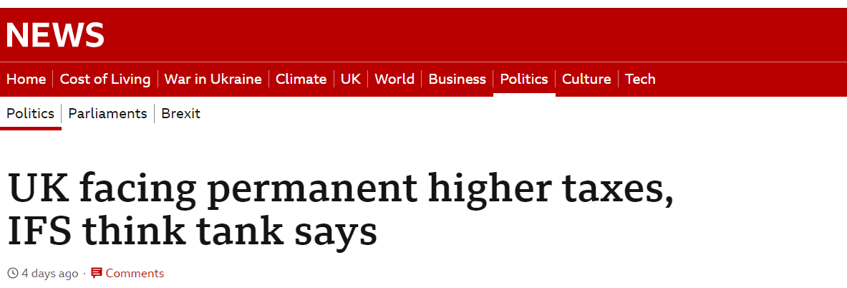
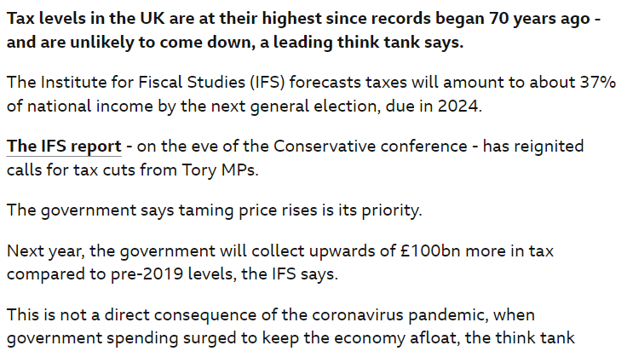
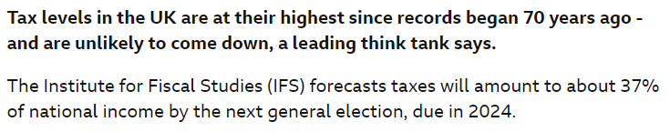
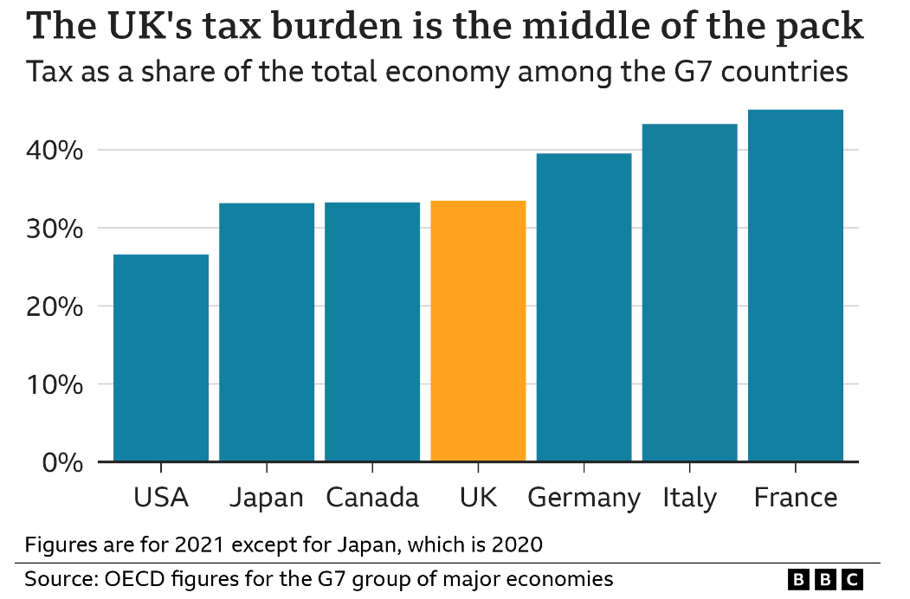
29th September 2023

Slide 5
How much income tax would the people below pay, and how much money do they take home?
a) Secretary, £22,000
b) Engineer, £48,000
c) Dentist, £72,000
d) CEO, £200,000
Personal Allowance | Basic Rate | Higher Rate | Additional Rate
Up to £12,570 | £12,571 - £50,270 | £50,271 - £125,140 | above £125,140
0% | 20% | 40% | 45%

Slide 6
How much income tax would the people below pay, and how much money do they take home?
Jan 23 = £16,232 / £55,768
Jan 24 = £16,292 / £55,708
Jan 23 = £1,886 / £20,114
Jan 24 = £1,886 / £20,114
a) Secretary, £22,000
b) Engineer, £48,000
c) Dentist, £72,000
d) CEO, £200,000
Jan 23 = £7,086 / £40,914
Jan 24 = £7,096 / £40,904
Jan 23 = £69,932 / £130,068
Jan 24 = £71,175 / £128,825
Personal Allowance | Basic Rate | Higher Rate | Additional Rate
Up to £12,570 | £12,571 - £50,270 | £50,271 - £125,140 | above £125,140
0% | 20% | 40% | 45%

Slide 7
How much national insurance would the people below pay, and considering this alongside income tax, how much money do they take home?
a) Secretary, £22,000
b) Engineer, £48,000
c) Dentist, £72,000
d) CEO, £200,000
Lower Earnings Limit | Upper Earnings Limit | Higher Rate
Up to £12,576 | £12,576.01 - £50,268 | Above £50,268
0% | 12% | 2%

Slide 8
How much national insurance would the people below pay, and considering this alongside income tax, how much money do they take home? ANSWERS
TAX = £1,886
NI = £1,131.60
Take home = £18,982
TAX = £16,232
NI = £4958.60
Take home = £50,709.40
a) Secretary, £22,000
b) Engineer, £48,000
c) Dentist, £72,000
d) CEO, £200,000
TAX = £7,086
NI = £4251.60
Take home = £36,662.40
TAX = £69,932
NI = £7,518.60
Take home = £122,549.40
Lower Earnings Limit | Upper Earnings Limit | Higher Rate
Up to £12,576 | £12,576.01 - £50,268 | Above £50,268
0% | 12% | 2%

Slide 9
Pension payments are deducted from salaries before tax and national insurance and thereby reduce the amount of income upon which tax and NI is due
Assuming each of our employees pay pension contributions of 10% of their salary…
How much do they contribute towards their pension each year?
How much tax & NI do they pay now and how does this compare to before?
What is their take home pay now?

Slide 10
How Does PAYE Work?
The UK tax year runs from 6th April to 5th April the following year.
The system by which employers deduct income tax from employee wages via PAYE is really logical and clever.
It adds up earnings and tax paid for the current year, assumes that current monthly earning will continue for the rest of the year then projects the likely total tax due and splits this equally between remaining months.
As the year progresses, these totals are refined until they are consolidated to meet the total tax due in the final month of the tax year.
This is the critical part

Slide 11
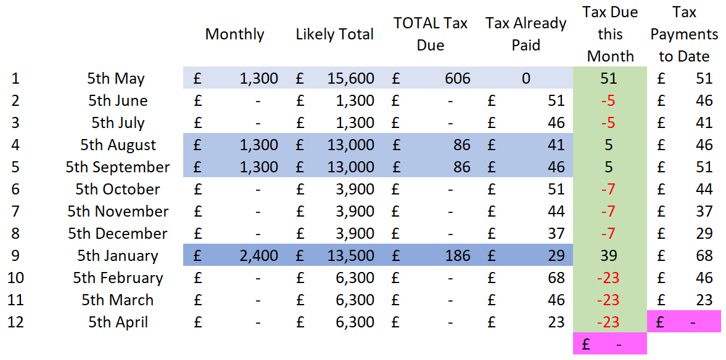
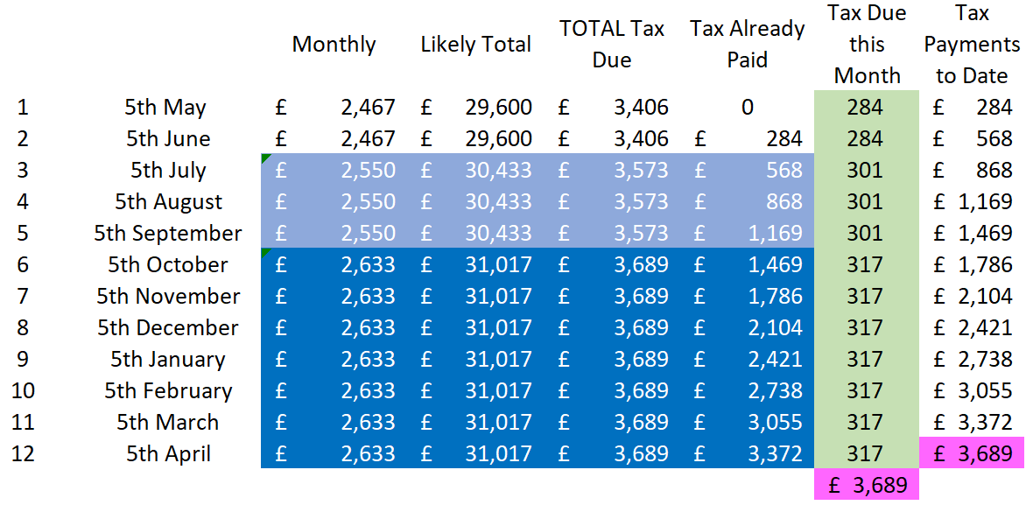
How Does PAYE Work - Example 1
The employee earning £29,600 pa who gets a £1000 pay rise in July and another £1000 pay rise in October. Paid monthly on 5th of each month.

Slide 12
How Does PAYE Work - Example 2
The holiday employee who earns £1300 over Easter then £2600 over the summer and £1300 over Christmas. Paid on 5th of May, August, September and January.

Slide 13
Tax Avoidance. vs Tax Evasion
Tax avoidance through sensible and legal financial planning is legal and sensible
Tax evasion through lying or non-declaration is illegal and naughty

Slide 14
This Week's Top Tips
https://www.moneysavingexpert.com/latesttip/
7th Feb 2023…
Car insurance up 15% - check NOW if you can save £100s
Top easy-access children's savings 3.75% for age 7-17
UK-born children aged 12 to 20ish had a Child Trust Fund opened in their name with £250 or £500 automatically added.
How much will you need to save for your children's uni?
https://www.moneysavingexpert.com/deals/

